Slide 1
RADAR: Risk Assessment for Database Attack Resistance
CSCI 699: Advanced Computer Security
Ashok Deb (adeb@usc.edu)
ASM Rizvi (asmrizvi@usc.edu)
Rajat Tandon (rajattan@usc.edu)
6 December, 2017

Slide 2









Bottom Line Up Front
Data – Analysis – Conclusion – Recommendation
PREVENT-reduce the probability an attack happens
R1: Two Factor Authentication
R2: Security Education
DETER-reduce the probability an attack happens to you
R3: Robust Email Handling
R4: Software Updates
R5: Encrypt Portable Devices
MITIGATE-increase the probability that you can survive an attack
R6: Backup Data
R7: Cybersecurity Insurance
Defense in Depth

Slide 3
Agenda
Background / Motivation
Data
Prevention Recommendations
Deterrence Recommendations
Mitigation Recommendations
Related Work
Future Work
Conclusion
Questions
Notes:
Douglas Shook was appointed chief information officer on January 1, 2016.
His portfolio includes the university’s wired and wireless networks, telecommunications, information security, business applications, educational technologies, Web Services, data center, and the Center for High-Performance Computing (HPC).
He holds a B.A. in English Literature and Journalism from the University of Michigan and a Ph.D. in Communication Research and Theory from the Annenberg School for Communication and Journalism.

Slide 4
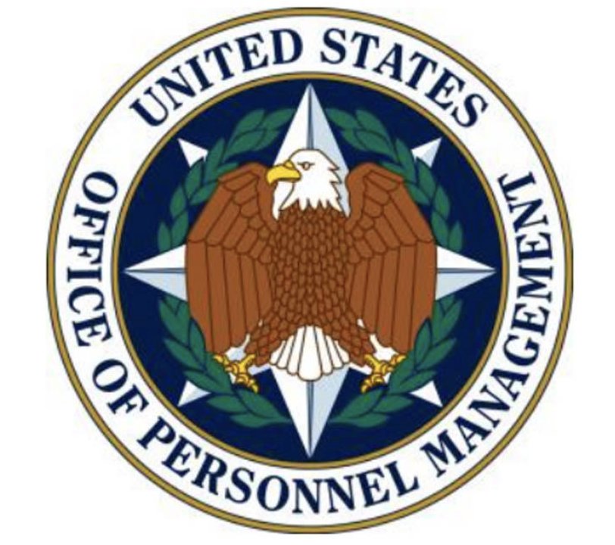

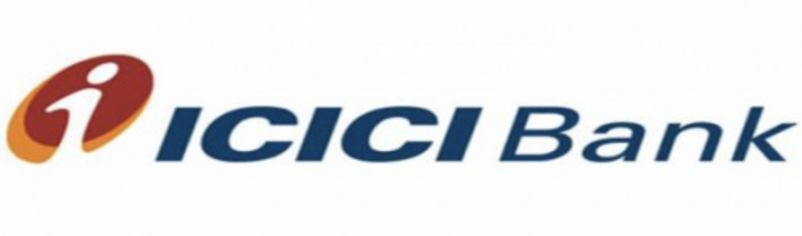


Background / Motivation
CIA operatives could be recovered from OPM hack²
US Military Joint Staff email down for 11 days¹
Bangladesh Bank Breach³
$101M withdrawn by hackers
$81M transferred to Philippines
$20M transferred to Sri Lanka
$38M recovered
Governor resigned
¹ http://www.dailymail.co.uk/news/article-3187344/Russia-hacked-Joint-Chiefs-Staff-shut-email-4-000-defence-department-employees-ELEVEN-DAYS.html
² https://hacked.com/cia-pulled-spies-beijing-opm-breach/
³ https://www.wired.com/2016/05/insane-81m-bangladesh-bank-heist-heres-know/
Notes:
Bangladesh bank attack
Loss of credit card – financial damage
OPM-–national security
10838 records

Slide 5
Data
11,696 breaches
100 Randomly selected breaches with 25% weightage to each set
Main Issue with Data
Privacy Rights
Vigilante.pw
Detailed Analysis
No central repository where all breaches can be found
Incomplete information about the breaches on web
Information is Beautiful
Wikipedia
Notes:
Where we got from
Citation at the bottom the side
Summary statistics

Slide 6
Data

Slide 7

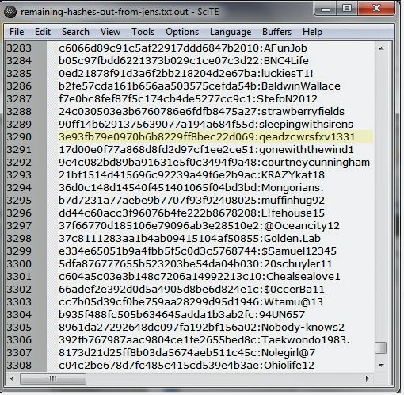
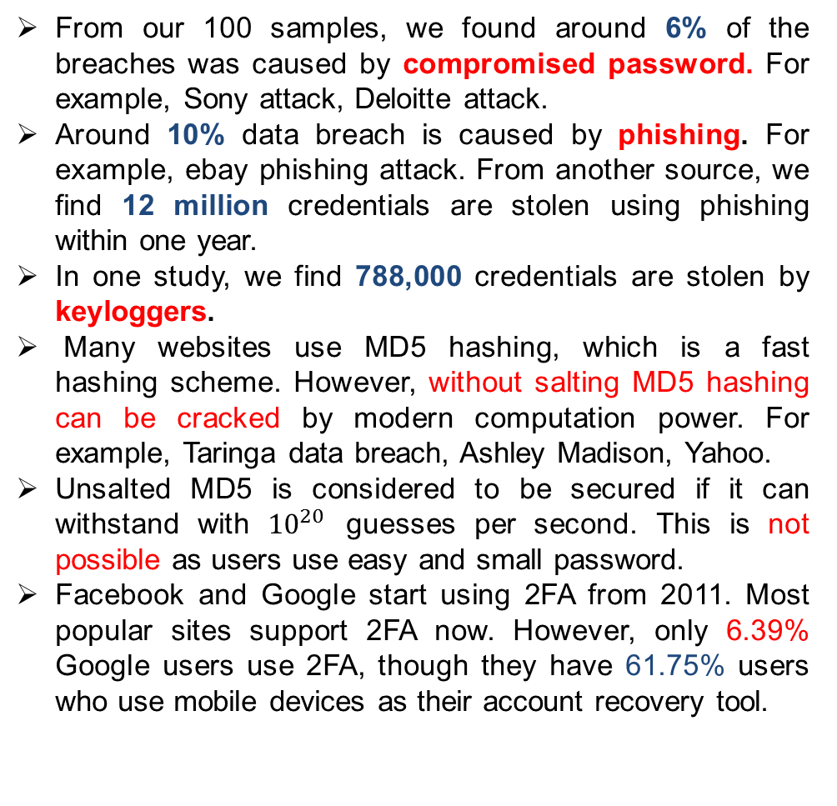
R1: Two Factor Authentication (2FA)
From our 100 samples, we found around 6% of the breaches was caused by compromised password. For example, Sony attack, Deloitte attack.
Around 10% data breach is caused by phishing. For example, ebay phishing attack. From another source, we find 12 million credentials are stolen using phishing within one year.
In one study, we find 788,000 credentials are stolen by keyloggers.
Many websites use MD5 hashing, which is a fast hashing scheme. However, without salting MD5 hashing can be cracked by modern computation power. For example, Taringa data breach, Ashley Madison, Yahoo.
Unsalted MD5 is considered to be secured if it can withstand with ${10}^{20}$ guesses per second. This is not possible as users use easy and small password.
Facebook and Google start using 2FA from 2011. Most popular sites support 2FA now. However, only 6.39% Google users use 2FA, though they have 61.75% users who use mobile devices as their account recovery tool.
Fig: Unsalted MD5 compromised.
Notes:
Thomas, Kurt, et al. "Data Breaches, Phishing, or Malware? Understanding the Risks of Stolen Credentials." (2017).
https://www.theregister.co.uk/2017/11/10/google_password_hijack/

Slide 8
R2: Security Education
Nearly two-thirds of people use the same password for their many different accounts.
Most popular choice of password in Taringa data-breach (out of 28 million password)
In a separate dataset, 4.55% users use login name as password (292, 658 users from 6, 428, 632 users).
Also, 15% users use single meaningful word as their passwords like common English words, country name, ZIP codes, birth-years, car-names, etc.
Password | No. of times used
123456789 | 160860
123456 | 90399
taringa | 49681
1234567890 | 22919
000000 | 17691
12345 | 14507
alejandro | 11205
DO NOT click all the links you get.
Check the link first before giving information.
How much trained your employees are about security? Companies like Ebay, Sony, and Deloitte had breaches from their employees’ account. There are organizations who give security training. We find 29 such organizations.
Educate people about misconceptions: in a survey, it was found that people do not realize the computing power to crack their passwords.
Notes:
Entrepreneur article by Carly Okyle: https://www.entrepreneur.com/article/242208
Taringa data breach: https://thehackernews.com/2017/09/taringa-data-breach-hacking.html
Shen, Chao, et al. "User practice in password security: An empirical study of real-life passwords in the wild." Computers & Security 61 (2016): 130-141.
Do your employees know what to do, and who to contact, if they suspect a data breach or cyber event
Pretend you experience a data breach, what do you do?

Slide 9
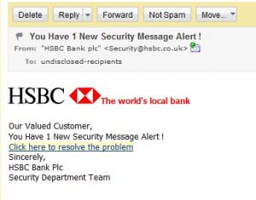
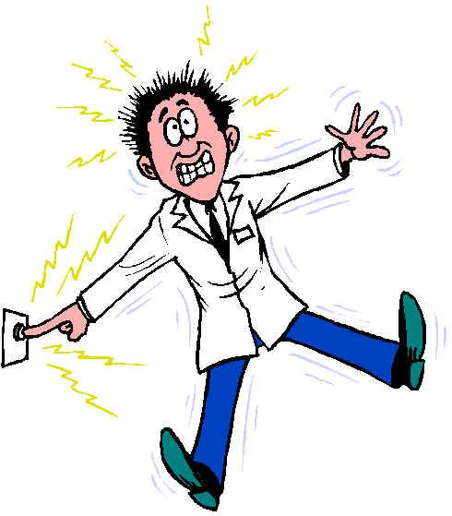
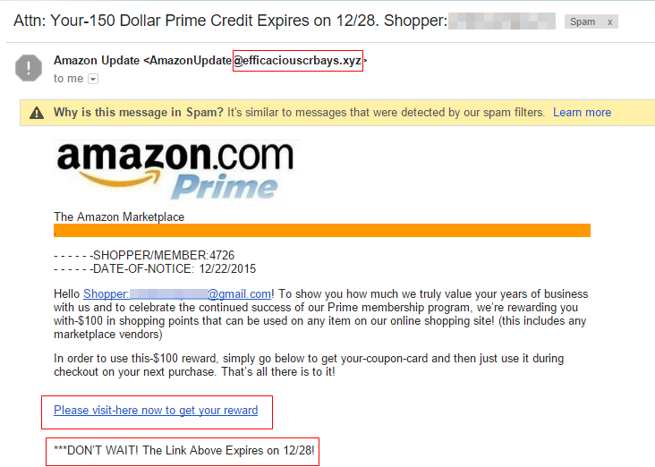
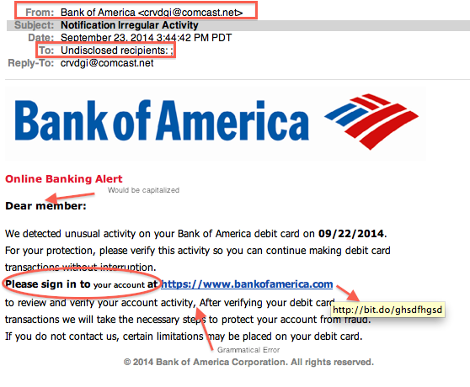

R3: Robust Email Handling
Think Before You Click!
Check the sender and sender’s domain carefully.
Segregate known vs unknown senders
Real-time analysis and inspection of your web traffic
Try to separate personal vs. professional emails
Don’t blindly follow the instructions given on a Third party email
“One wrong click may give you a flick.”
-Rajat Tandon
Notes:
https://www.csoonline.com/article/2132618/phishing/social-engineering-11-tips-to-stop-spear-phishing.html

Slide 10
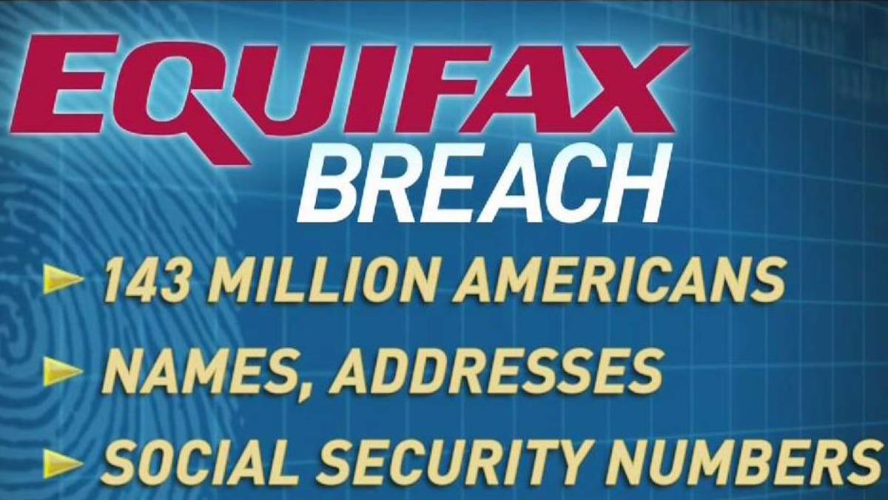
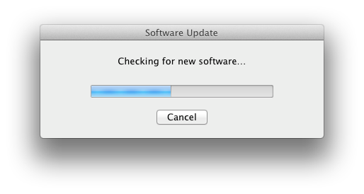
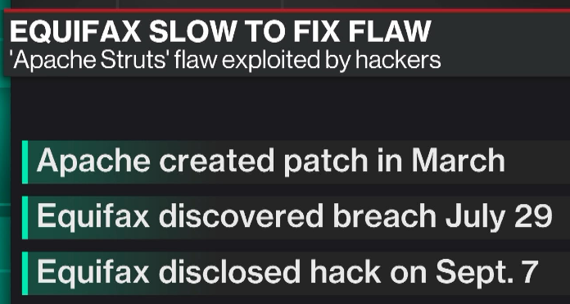
R4: Software Updates
An analyst firm surveys 318 companies and finds that more than 80 percent of discovered breaches occurred due to patches pending for more than 10 days and even up to a year.
The vulnerability that caused the equifax breach was disclosed back in March.
There were clear and simple instructions of how to remedy the situation.
Companies should have procedures in place to follow such advice promptly.
Notes:
https://www.wired.com/story/equifax-breach-no-excuse/

Slide 11
R5: Encrypt Portable Devices
We found a numerous number of breaches from stolen laptop, portable devices, etc.
AT&T
A laptop was stolen from a car containing unencrypted Social Security numbers and bonus/salary info of AT&T employees in 2008.
Starbucks
A laptop was stolen that contained private information on 97,000 employees, including names, addresses and Social Security numbers.
Los Angeles County Child Support Services
Three laptops containing personal information including about 130,500 Social Security numbers” most without names, 12,000 individuals' names and addresses, and more than 101,000 child support case numbers were apparently stolen from the department's office.
https://nakedsecurity.sophos.com/2012/11/15/nasa-data-breach-stolen-laptop/https://nakedsecurity.sophos.com/2012/11/15/nasa-data-breach-stolen-laptop/
Notes:
In March 2011, algorithms used to command and control the International Space Station were exposed.
In March 2012, it was the personally identifiable information (PII) of 2,300 employees and students.
In another incident, it was sensitive data on NASA’s Constellation and Orion programs.
This time around, on 31 October, it was PII on an unspecified, but large, number of NASA employees and contractors.
All these instances involved the theft of unencrypted laptops from NASA. With this most recent theft, the space agency is finally doing something about these incidents, beyond the limited scope of its previous remediation efforts.
NASA announced on Tuesday that, effective immediately, the agency is jumping on the encryption fast track.
By 21 December, no NASA-issued laptops containing sensitive information will be allowed to leave a NASA facility unless whole disk encryption software is enabled or sensitive files are individually encrypted.

Slide 12
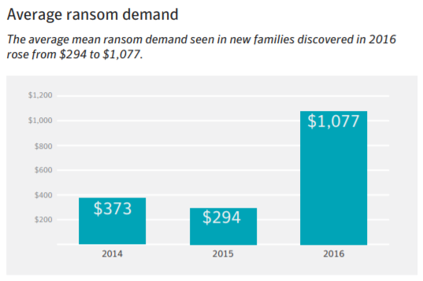
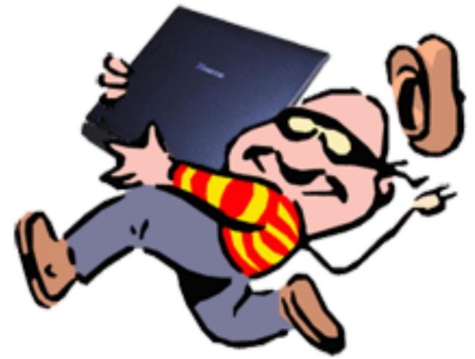
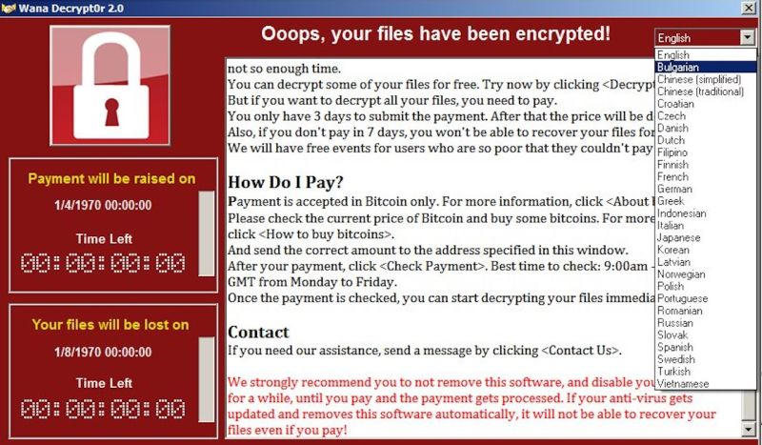
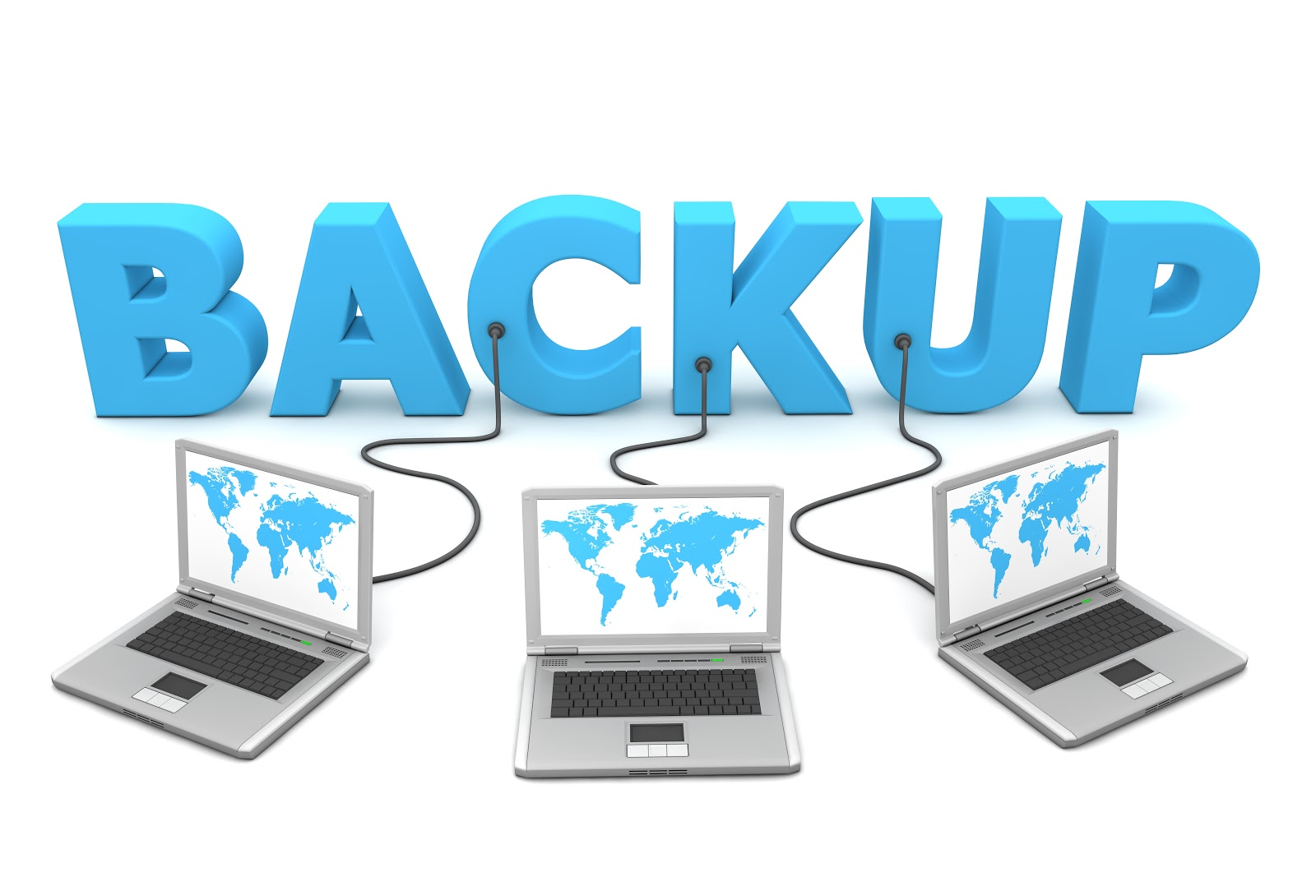
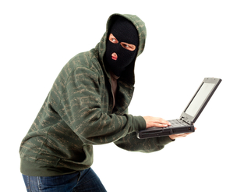

R6: Backup data
Every 10 seconds, a consumer gets hit with ransomware.
A wrong click by a user can lay the best laid (and most expensive) security plans to waste.
Phishing email attachments have become the #1 delivery vehicle for ransomware
Notes:
https://www.csoonline.com/article/3212260/ransomware/the-5-biggest-ransomware-attacks-of-the-last-5-years.html
https://blog.barkly.com/ransomware-statistics-2016
Hosptial payed the money
Ransom ware
Does your company isolate customer information databases and payment/point-of-sale systems from other, less secure systems?

Slide 13
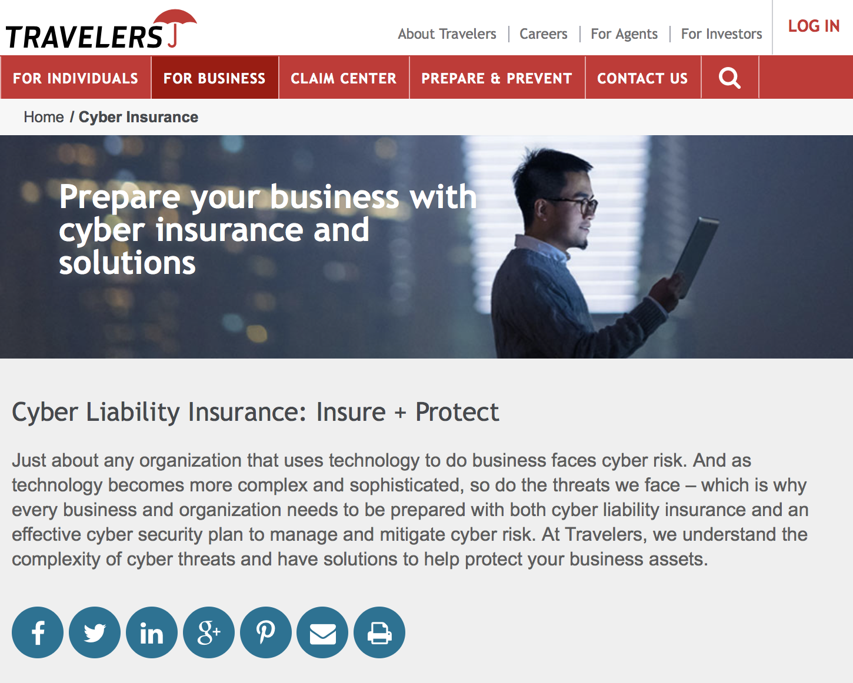
R7: Cybersecurity Insurance
Cybersecurity insurance can mitigate losses from a variety of cyber incidents, including data breaches, business interruption, and network damage.¹
Encourage the adoption of preventative measures in return for more coverage.¹
Encourage the implementation of best practices by basing premiums on an insured’s level of self-protection.¹
Encourage a cyber incident data repository to identify emerging cybersecurity best practices and assist cybersecurity insurance policies that reward businesses for adopting and enforcing those best practices.¹
²
The average number of records lost 30K³
Average notifications costs: $500K³
Average post breach costs: $1.6M³
Average lost business costs: $3.3M³
Average detection costs: $400K³
Average defense and settlement costs: $800K⁴
¹Department of Homeland Security National Protection and Programs Directorate (NPPD) https://www.dhs.gov/cybersecurity-insurance
²Travelers Insurance https://www.travelers.com/cyber-insurance
³Ponemon 2014 Institute Cost of Data Breach Study https://www-935.ibm.com/services/multimedia/SEL03027USEN_Poneman_2014_Cost_of_Data_Breach_Study.pdf ⁴NetDiligence 2013 Cyber Liability & Data Breach Study https://netdiligence.com/wp-content/uploads/2016/05/CyberClaimsStudy-2013.pdf
Notes:
Lost Data
If a breach does occur, a Travelers cyber policy can cover breach notifications and remediation expenses, subject to the applicable retention. It also can cover defense expenses such as responding to and cooperating with regulatory investigators.
Lost Devices
Notification Requirements
Notifying customers of a breach and other post-breach responses, which is mandated by law, can add up, averaging $1.72 million according to one survey of U.S. businesses.* As part of the a cyber policy, Travelers would refer the customer to a law firm to serve as counsel and breach coach and help reimburse those costs, subject to the applicable retention.
Forensics
Computer forensics teams can determine the extent of a breach and whether private customer information may have been compromised. A Travelers cyber policy would reimburse the insured, subject to applicable retention, for computer forensic experts.

Slide 14
Conclusion
Data – Analysis – Conclusion – Recommendation
PREVENT-reduce the probability an attack happens
R1: Two Factor Authentication
R2: Security Education
DETER-reduce the probability an attack happens to you
R3: Robust Email Handling
R4: Software Updates
R5: Encrypt Portable Devices
MITIGATE-increase the probability that you can survive an attack
R6: Backup Data
R7: Cybersecurity Insurance
Defense in Depth

Slide 15
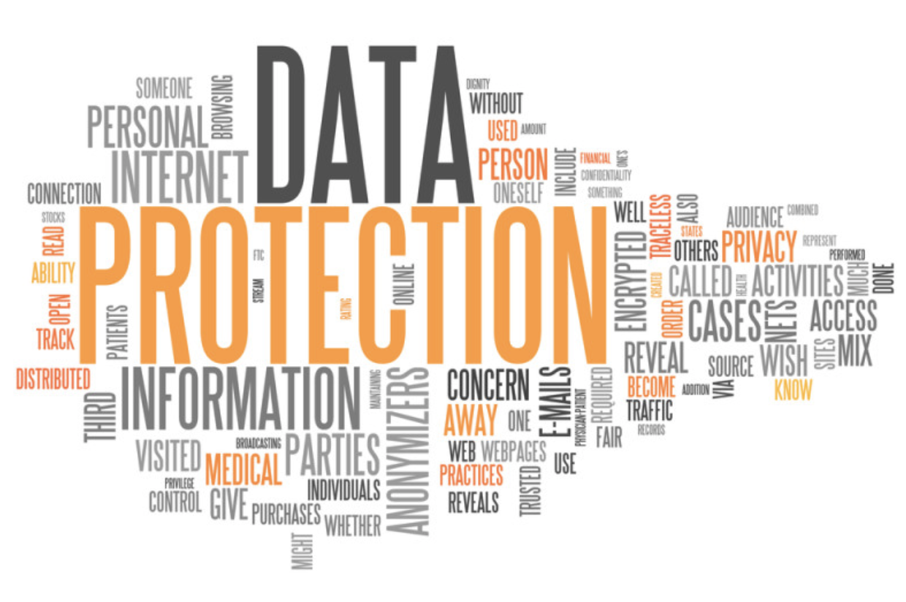
Questions
Our data, draft paper and slides are available at:
https://github.com/A-Deb/Data_Breaches

